Slide 1
Object/Relational Mapping
Fundamental Concepts and Concerns When Using O/R Mapping in Enterprise Applications

Slide 2
Topics in this session
The Object/Relational mismatch
ORM in context
Benefits of O/R Mapping

Slide 3
Topics in this session
The Object/Relational mismatch
ORM in context
Benefits of O/R Mapping

Slide 4
The Object/Relational Mismatch (1)
A domain object model is designed to serve the needs of the application
  Organize data into abstract concepts that prove useful to solving the domain problem
  Encapsulate behavior specific to the application
  Under the control of the application developer

Slide 5
The Object/Relational Mismatch (2)
Relational models relate business data and are typically driven by other factors:
  Performance
  Space
Furthermore, a relational database schema often:
  Predates the application
  Is shared with other applications
  Is managed by a separate DBA group

Slide 6
Object/Relational Mapping
Object/Relational Mapping (ORM) engines exist to mitigate the mismatch
Spring supports all of the major ones:
  Hibernate
  Toplink
  JDO
  Java Persistence API (JPA)
This session will focus on Hibernate

Slide 7
Topics in this session
The Object/Relational Mismatch
ORM in context
Benefits of modern-day ORM engines

Slide 8
ORM in context
For the Reward Dining domain
  The database schema already exists
  Several applications share the data
Reward Network
Account Management Portal
Merchant
Reporting
Database

Slide 9
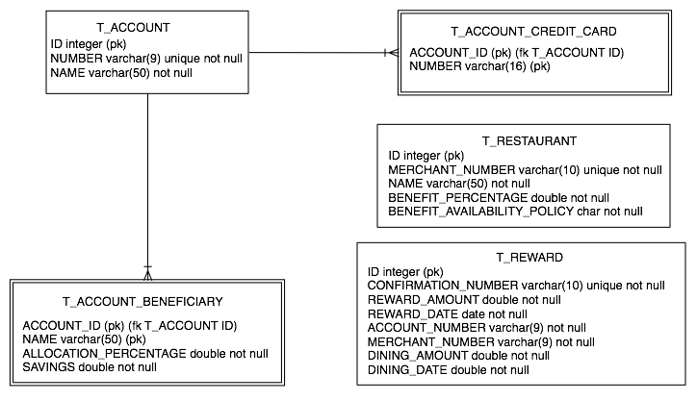
The integration database schema

Slide 10
The RewardNetwork application
Rewards an account for dining
  By asking the Restaurant where the dining occurred to calculate the benefit amount
  Then, by making a contribution to the Account that initiated the dining

Slide 11
The RewardNetwork application
rewardAccountFor
(Dining)
RewardNetworkImpl
calculateBenefitFor
(Account, Dining)
Restaurant
makeContribution(MonetaryAmount)
Account

Slide 12
The Restaurant module
Restaurant benefit calculations are based on a:
  Benefit percentage
    e.g. 4% of the dining bill
  Benefit availability policy
    e.g. some Restaurants only reward benefit on certain days
Restaurant
<< interface >>
benefitPercentage
BenefitAvailabilityPolicy
calculateBenefitFor(Account, Dining)

Slide 13
The Account module
Account contributions are distributed among the account’s beneficiaries
  Each beneficiary has an allocation percentage
  The total beneficiary allocation must add up to 100%
Account
Beneficiary
makeContribution(amount)
isValid()
1..*
allocationPercentage
savings

Slide 14
Account and Restaurant data
All account and restaurant data is stored in the database
  Data is needed by several applications
What are the major challenges in mapping this object model to the relational model?

Slide 15
O/R Mismatch: Granularity (1)
In an object-oriented language, cohesive fine-grained classes provide encapsulation and express the domain naturally
In a database schema, granularity is typically driven by normalization and performance considerations

Slide 16
O/R Mismatch: Granularity (2)
just one example…
Domain Model in Java
Table in Database
Customer
CUSTOMER
- customerId
- firstName
- lastName
EmailAddress
CUST_ID <<PK>>
FIRST_NAME
LAST_NAME
EMAIL
PHONE
STREET_NUMBER
STREET_NAME
CITY
STATE
ZIP_CODE
PhoneNumber
Address
- streetNumber
- streetName
city
state
zipCode
Notes:
“Third normal form” is great for databases, not for OO systems

Slide 17
O/R Mismatch: Identity (1)
In Java, there is a difference between Object identity and Object equivalence:
  x == y identity (same memory address)
  x.equals(y) equivalence
In a database, identity is based solely on primary keys:
  x.getEntityId().equals(y.getEntityId())
Notes:
“Is anyone still using == ? Why ?”

Slide 18
O/R Mismatch: Identity (2)
When working with persistent Objects, the identity problem leads to difficult challenges
2 Objects may be logically equivalent, but only one has a value set for its primary key field
Some of the challenges:
  Implement equals to accommodate this scenario
  Determine when to update and when to insert
  Avoid duplication when adding to a Collection
Notes:
With Hibernate…
1) A transient object may be equivalent to an attached object in terms of the Java equals() method, but the transient object will not have a primary key value
2) Within an active Session, Hibernate only allows one object per database identity (therefore x == y is guaranteed if x.getEntityId().equals(y.getEntityId()))

Slide 19
O/R Mismatch:
Inheritance and Associations (1)
In an object-oriented language:
  IS-A relations are modeled with inheritance
  HAS-A relations are modeled with composition
In a database schema, relations are limited to what can be expressed by foreign keys

Slide 20
O/R Mismatch:
Inheritance and Associations (2)
Bi-directional associations are common in a domain model (e.g. Parent-Child)
  This can be modeled naturally in each Object
In a database:
  One side (parent) provides a primary-key
  Other side (child) provides a foreign-key reference
For many-to-many associations, the database schema requires a join table

Slide 21
Topics in this session
The Object/Relational Mismatch
ORM in Context
Benefits of O/R Mapping

Slide 22
Benefits of ORM
Object Query Language
Automatic Change Detection
Persistence by Reachability
Caching
  Per-Transaction (1st Level)
  Per-DataSource (2nd Level)

Slide 23
Object Query Language
When working with domain objects, it is more natural to query based on objects.
  Query with SQL:
  Query with object properties and associations:
SELECT c.first_name, c.last_name, a.city, ...
FROM customer c, customer_address ca, address a
WHERE ca.customer_id = c.id
AND ca.address_id = a.id
AND a.zip_code = 12345
“from Customer c where c.address.zipCode = 12345”

Slide 24
Automatic Change Detection
When a unit-of-work completes, all modified state will be synchronized with the database.
Service
Repository1
Repository2
UnitOfWork
invoke(input)
begin
find
find
modify
commit
Database
flush
output
Notes:
Don’t need to know if doing an INSERT or UPDATE, and if doing an UPDATE we don’t need to know what fields were changed (if any at all).

Slide 25
Persistence by Reachability (1)
When a persistent object is being managed, other associated objects may become managed transparently:
Order order = orderRepository.findByConfirmationId(cid);
// order is now a managed object – retrieved via ORM
LineItem item = new LineItem(..);
order.addLineItem(item);
// item is now a managed object – reachable from order

Slide 26
Persistence by Reachability (2)
The same concept applies for deletion:
Order order = orderRepository.findByConfirmationId(cid);
// order is now a managed object – retrieved via ORM
List<LineItem> items = order.getLineItems();
for (LineItem item : items) {
if (item.isCancelled()) { order.removeItem(item); }
// the database row for this item will be deleted
}
if (order.isCancelled()) {
orderRepository.remove(order);
// all item rows for the order will be deleted
}
Notes:
NOTE: this assumes that Hibernate cascading has been configured for ‘delete’ as well as ‘delete-orphan’

Slide 27
Caching
The first-level cache (1LC) is scoped at the level of a unit-of-work
  When an object is first loaded from the database within a unit-of-work it is stored in this cache
  Subsequent requests to load that same entity from the database will hit this cache first
The second-level cache (2LC) is scoped at the level of the SessionFactory
  Reduce trips to database for read-heavy data
  Especially useful when a single application has exclusive access to the database

